Slide 1
Review
LINEAR REGRESSION
1

Slide 2
Linear Regression: A Visual Perspective
𝒉 𝑿 = 𝑾 𝑻 𝑿 = 𝒘 𝟎 𝒙 𝟎 + 𝒘 𝟏 𝒙 𝟏 + 𝒘 𝟐 𝒙 𝟐 + ⋯ + 𝒘 𝒏 𝒙 𝒏
Compute Error: 𝑦 − 𝑦 ො
𝑦 ො
∑
𝑤 0
+1
𝑤 1
𝑤 2
𝑤 𝑛
𝑥 1
𝑥 2
…
𝑥 𝑛
2

Slide 3
Polynomial
Regression
3

Slide 4
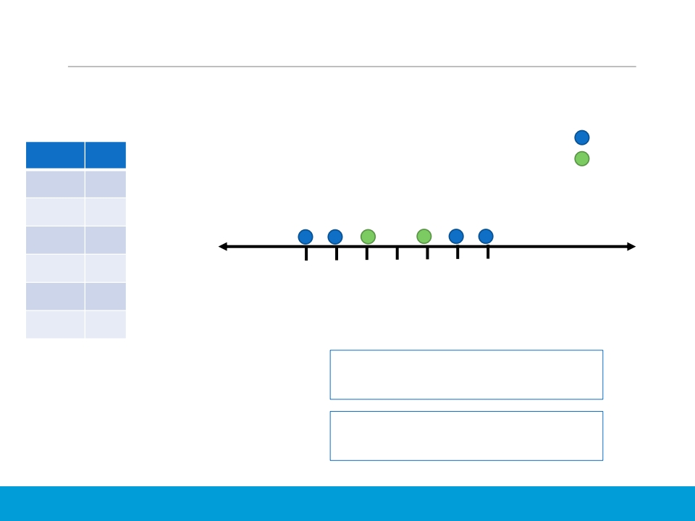
Polynomials: Intuition
❑ Suppose the following dataset
𝒙 | 𝒚
−3 | A
−2 | A
−1 | B
1 | B
2 | A
3 | A
A
B
𝑥
−3 −2 −1 −0
1
2
3
We will consider classification label
as it is easier to understand…
Can a straight line separate out the
two classes?
It is not possible to “fit” the data
with a single line!
4

Slide 5
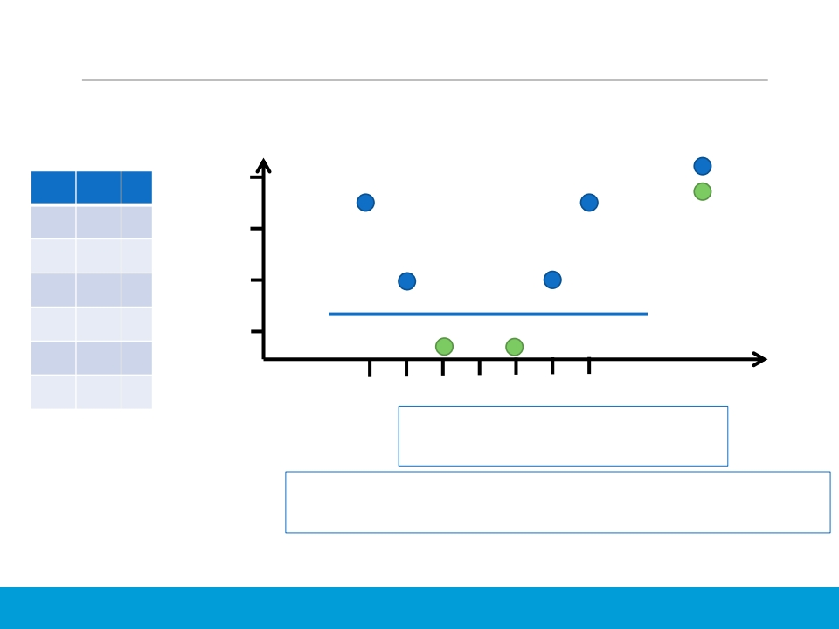
Polynomials: Intuition
❑ We can always take higher powers of the features to make the data
linearly separable.
𝒙 | 𝟐 𝒙 | 𝒚
−3 | 9 | A
−2 | 4 | A
−1 | 1 | B
1 | 1 | B
2 | 4 | A
3 | 9 | A
A
B
10
8
𝑥 2 4
2
𝑥
−3 −2 −1 −0
1
2
3
Now we can fit a straight line to
separate these two classes.
If it is still not possible to linearly separate the data, maybe
adding a 3 rd dimension (𝒙 𝟑 𝟏 ) would do the trick!
Note: This is also called “Polynomial Kernel” and the power that
we choose is called degree of polynomial. More on “Kernels” later.
5

Slide 6
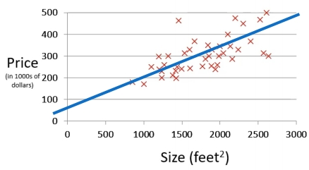
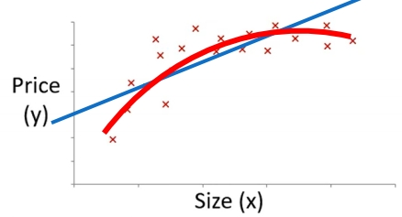
Polynomial Regression
❑ The relationship between input features and the output label is Linear !
❑ The line we were fitting was a straight line!
A straight line is not a
good fit in this case
A line with some
curve would be a
better fit…
6

Slide 7
Polynomial Regression
❑ Visualizing Polynomial Degree
▪ https://www.desmos.com/calculator
7

Slide 8
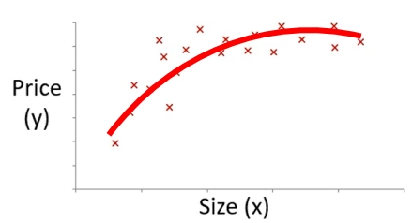
Polynomial Regression
𝒘 𝟎 + 𝒘 𝟏 𝒙 + 𝒘 𝟐 𝒙 𝟐
𝒘 𝟎 + 𝒘 𝟏 𝒙 + 𝒘 𝟐 𝒙 𝟐 + 𝒘 𝟑 𝒙 𝟑
One feature is now converted to three features!
𝒉𝒙=𝒘𝟎+𝒘𝟏𝒙𝟏+𝒘𝟐𝒙𝟐+𝒘𝟑𝒙𝟑
𝟐𝟑 𝒉𝒙=𝒘𝟎+𝒘𝟏(𝒔𝒊𝒛𝒆)+𝒘𝟐𝒔𝒊𝒛𝒆+𝒘𝟑𝒔𝒊𝒛𝒆
𝑥 1 = 𝑠𝑖𝑧𝑒
𝑥 2 = 𝑠𝑖𝑧𝑒 2
𝑥 3 = 𝑠𝑖𝑧𝑒 3
Note: Feature scaling becomes much more important now (as you are
taking powers of the original value, making them much much bigger)
8

Slide 9
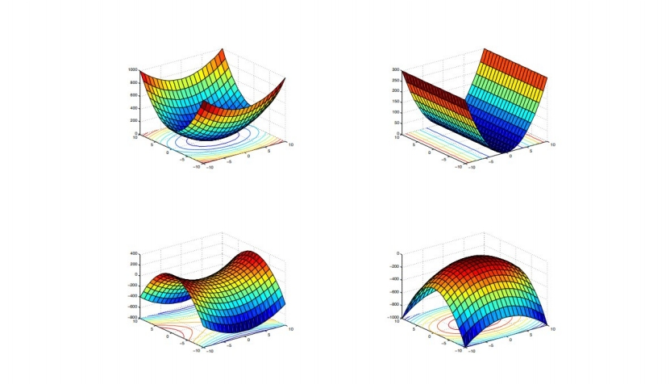
Error Surfaces are Still Planes
Credit: http://mezeylab.cb.bscb.cornell.edu/labmembers/documents/supplement%205%20-%20multiple%20regression.pdf
9

Slide 10
Bias and Variance
Tradeoff
10

Slide 11
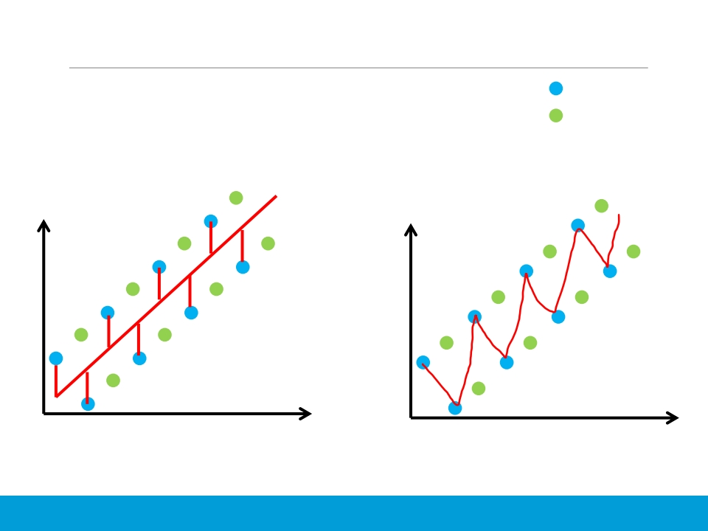
The Fitting Problem
❑ Is it a good idea to always look for 0 training error?
Training Data
Testing Data
What is MSE on this testing data?
What is MSE on this testing data?
𝑦
𝑦
Some training error
Some testing error
𝑥
What is MSE on this training data?
0 training error
High testing error
𝑥
What is MSE on this training data?
11

Slide 12
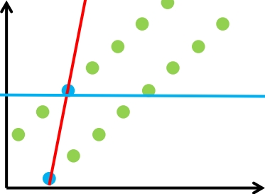


The Fitting Problem
Training Data
Testing Data
High bias
This is a high variance
model as the
performance of the
𝑦
model “varies” a lot
across train and test
datasets.
High variance
We draw a line with a
very high confidence
𝑥
𝒉 𝒙 = 𝒘 𝟎 + 𝒘 𝟏 𝒙
The slope of the line is high that means the
value of 𝑤 1 is really high (i.e., the model is
giving high “weight to feature 𝑥 .
The slope of the line is 0 that means the
value of 𝑤 0 is really high (i.e., high bias). The
model is not giving any “weight” to feature 𝑥 .
12

Slide 13
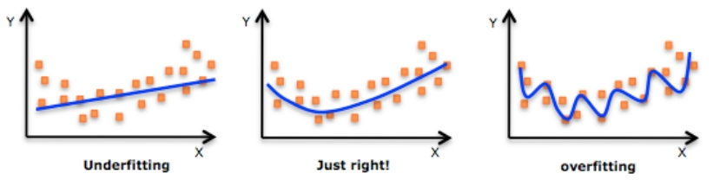
The Fitting Problem
❑ Bias and Variance
High Bias
Low Bias, Low
Variance
High Variance
13

Slide 14

A Real Example…
Don’t learn training data specific features…
Credit: http://www.petanimalexpo.co.nz/
14

Slide 15
Bias and Variance
❑ Bias: The difference between the average prediction of our model and the correct
value which we are trying to predict.
▪ If the average predicted values are far off from the actual values, then the bias is high.
▪ Model with high bias pays little attention to the training data and oversimplifies the model
▪ When a model has a high bias, then it implies that the model is too simple and does not
capture the complexity of the data, thus underfitting the data.
▪ It leads to a high error on both training and test data.
❑ Variance: The variability of model prediction for a across datasets (data points), i.e.,
how scattered are the predicted values from the actual values.
▪ Model with high variance pays a lot of attention to the training data and does not
generalize on the data which it has not seen before.
▪ As a result, such model performs very well on training data, but has high error rates on
test data.
▪ High variance causes overfitting that implies that the algorithm models random noise
present in the data.
Credit: Elements of Statistical Learning by Trevor Hastie, Robert Tibshirani and Jerome Friedman
https://towardsdatascience.com/understanding-the-bias-variance-tradeoff-165e6942b229
15

Slide 16
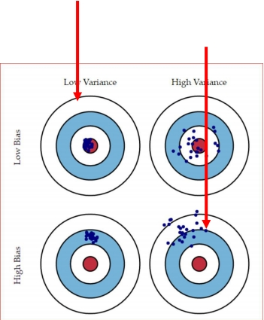
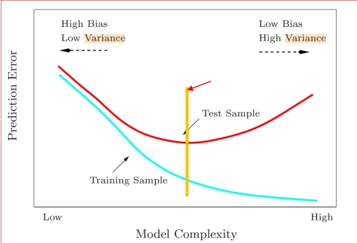
Bias and Variance
Ideal Situation
Worst Situation
A good point to
stop training
Credit: Elements of Statistical Learning by Trevor Hastie, Robert Tibshirani and Jerome Friedman
https://towardsdatascience.com/understanding-the-bias-variance-tradeoff-165e6942b229
https://medium.com/datadriveninvestor/bias-and-variance-in-machine-learning-51fdd38d1f86
16

Slide 17
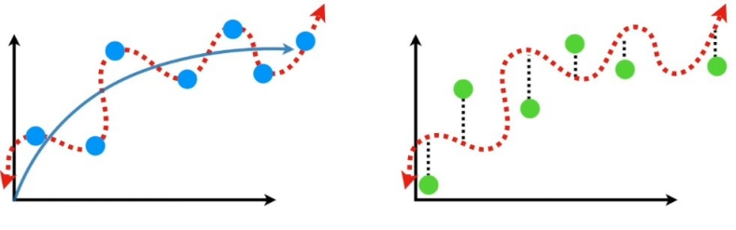
Low Bias and High Variance
Training Dataset
Testing Dataset
Because this model fits well to the training set (blue
dots) but not so well on the testing set (green dots),
we say that the model is “Overfitting ”
17

Slide 18
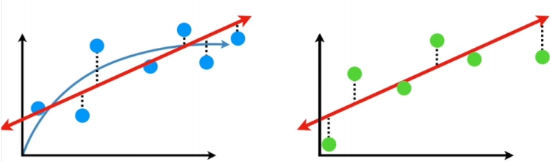
High Bias and Low Variance
Training Dataset
Testing Dataset
Because this model does not fit to the training set
(blue dots) but fits well on the testing set (green
dots), we say that the model is “ Underfiting ”
18

Slide 19
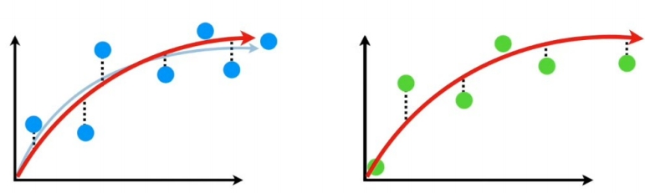
An Ideal Algorithm should…
❑ Have lower bias so it can accurately model true relationship
❑ Have low variability so it can predict consistently across different
datasets (splits)!
Training Dataset
Testing Dataset
19

Slide 20
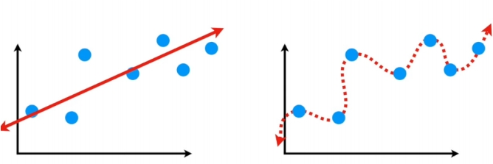
Bias-Variance Tradeoff
❑ This is achieved by finding sweet spot between simple model (left) and
complex model (right)
Simple Model
Complex Model
How to find the sweet spot between Bias and Variance?
20

Slide 21
Finding Sweet Spot between Simple and Complex Model
❑ Bagging
❑ Feature Reduction
▪ Feature Selection (Statistical, Automated, and Manual)
▪ Feature Extraction
❑ Regularization
▪ Reduce magnitude/values of parameters 𝑤 𝑗
▪ Works well when we have a lot of features, each of which contributes a bit to prediction
❑ Boosting
These solutions are used to remove overfitting
21

Slide 22
Bias and Variance: Summary
❑ High Bias:
▪ High Training Error
▪ Validation Error or Testing Error is Close to Training Error
❑ High Variance:
▪ Low Training Error
▪ High Validation Error or High Testing Error
❑ Fixing High Bias (possibly): It’s due to simple model.
▪ Add more input features
▪ Add more complexity by introducing polynomial features
▪ Decrease regularization term More on regularization later…
❑ Fixing High Variance (possibly): It’s due complex model.
▪ Getting more training data
▪ Reduce input features
▪ Increase regularization term
Credit: Elements of Statistical Learning by Trevor Hastie, Robert Tibshirani and Jerome Friedman
https://towardsdatascience.com/understanding-the-bias-variance-tradeoff-165e6942b229
22

Slide 23
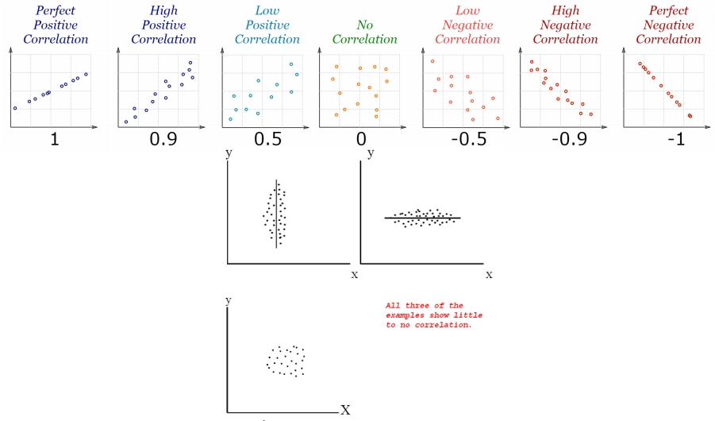
Manual Feature Selection
❑ Recall Correlation
Should we have a
low or high
correlation between
input features and
the output label?
23

Slide 24
Manual Feature Selection: Example
❑ Consider a dataset that has an output label “# shark attacks”
#swimmers | watched_jaws | temp | stock_price | #attacks
… | … | … | … | …
… | … | … | … | …
❑ attacks: Number of shark attacks (output variable)
❑ swimmers: Number of swimmers in water
❑ watched_jaws: Percentage of swimmers who watched iconic Jaws movies
❑ temp: Average temperature of the day
❑ stock_price: The price of your favorite tech stock that day (a totally
unrelated variable)
Credit: https://scienceloft.com/technical/understanding-lasso-and-ridge-regression/
24

Slide 25
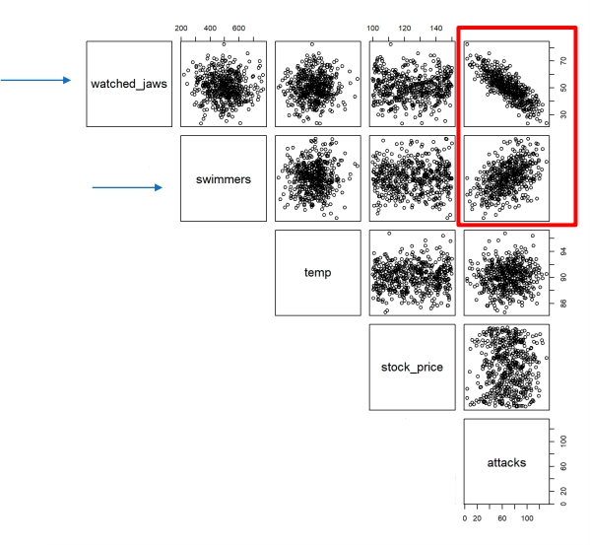
Manual Feature Selection: Example
❑ Plot all features and label as a scatter plot
Why “ watched_jaws ”
is important?
Why “# swimmers” is
important?
What are the best features with
respect to class label “attacks”?
Credit: https://scienceloft.com/technical/understanding-lasso-and-ridge-regression/
25

Slide 26
Automatic Feature Selection
❑ Can we somehow “minimize” the contribution of least important features
in the output?
▪ Lasso Regression
26

Slide 27
Reference
❑ Josh Strammer (StatQuest)
▪ https://www.youtube.com/channel/UCtYLUTtgS3k1Fg4y5tAhLbw
27

Slide 28
Book Reading
❑ Murphy – Chapter 7
28

